Slide 1
Spark Join strategies

Slide 2
What is a Join in Spark?
A Join is used to combine two datasets (DataFrames/Tables) based on a common column.
Example:
  customers table → customer_id, name
  orders table → order_id, customer_id, amount
  We join using customer_id.
Why Join Strategy Matters
Spark runs on multiple machines (cluster).
When joining:
  Data may exist on different machines
  Data may need to move across network
  Data may need sorting or hashing
⚠️ Shuffle = Expensive
⚠️ Wrong strategy = Performance disaster
Choosing correct strategy = ✅ Faster jobs + ✅ Less memory + ✅ Less cost

Slide 3
What Happens Internally During a Join?
When you write:
df1.join(df2, "id")
Spark does:
  Logical Plan created
  Catalyst Optimizer analyzes
  Chooses physical join strategy
  Executes across executors
  Possibly shuffles data
  Combines matching rows
When Spark Chooses Strategy Automatically
Spark decides based on:
  Table size
  spark.sql.autoBroadcastJoinThreshold (default 10MB)
  Join type (inner, outer, cross)
  Spark version
Example
  Small + Large → Broadcast Hash Join
  Large + Large → Sort Merge Join

Slide 4
Broadcast Hash Join
If one table is small, Spark sends (broadcasts) it to all executors.
When Spark Uses It
One table < 10MB (default)
Equi-join (= condition)
When To Use
Small dimension table
Large fact table
When NOT To Use
Small table > memory
Both tables large
Step-by-Step Internal Working
  Driver identifies small table
  Small table collected
  Broadcast to all executors
  Executors build hash table
  Large table scanned
  Matching done locally (no shuffle)

Slide 5
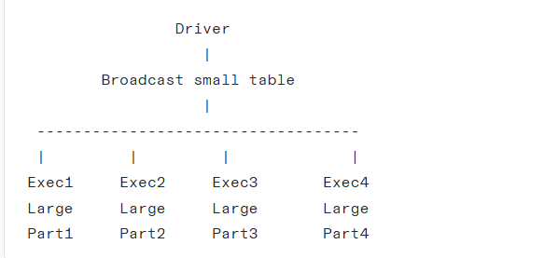
No shuffle
  Very fast
  PySpark Code
Python
from pyspark.sql.functions import broadcast
result = orders.join(broadcast(customers), "customer_id")
SQL
SELECT /*+ BROADCAST(customers) */ * FROM orders
JOIN customers
ON orders.customer_id = customers.customer_id;
Performance Impact
Fastest join
No shuffle
Uses executor memory

Slide 6
Shuffle Hash Join
Both tables are shuffled by join key.
Each executor builds hash table locally.
When Spark Uses It
  Equi-join
  Medium sized tables
When sort merge disabled
Internal Steps
  Both tables shuffled by key
  Same keys go to same executor
  One side builds hash map
  Other side probes hash
Performance
  ⚠️ Shuffle required
  ⚠️ Network heavy
  ✅ Faster than sort merge sometimes

Slide 7
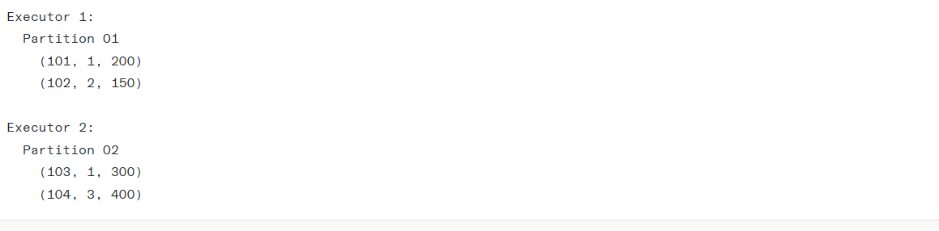
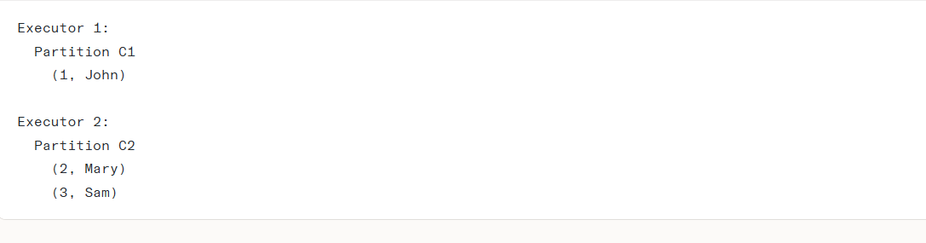
Data Before Shuffle (Distributed Across Cluster)
  Assume we have 2 executors
  Each table has 2 partitions
Orders Table (Large Table)
Current Distribution (Random)
order_id | customer_id | amount
101 | 1 | 200
102 | 2 | 150
103 | 1 | 300
104 | 4 | 500
Problem Before Shuffle
Look at key = 1
Orders for customer_id=1 are in:
  Executor 1
  Executor 2
Customer row for id=1 is only in:
Executor 1
  👉 Data is scattered
  👉 Same key is NOT in same location
  👉 Join cannot happen yet
So Spark performs SHUFFLE.
customer_id | name
1 | John
2 | Mary
3 | Sam

Slide 8
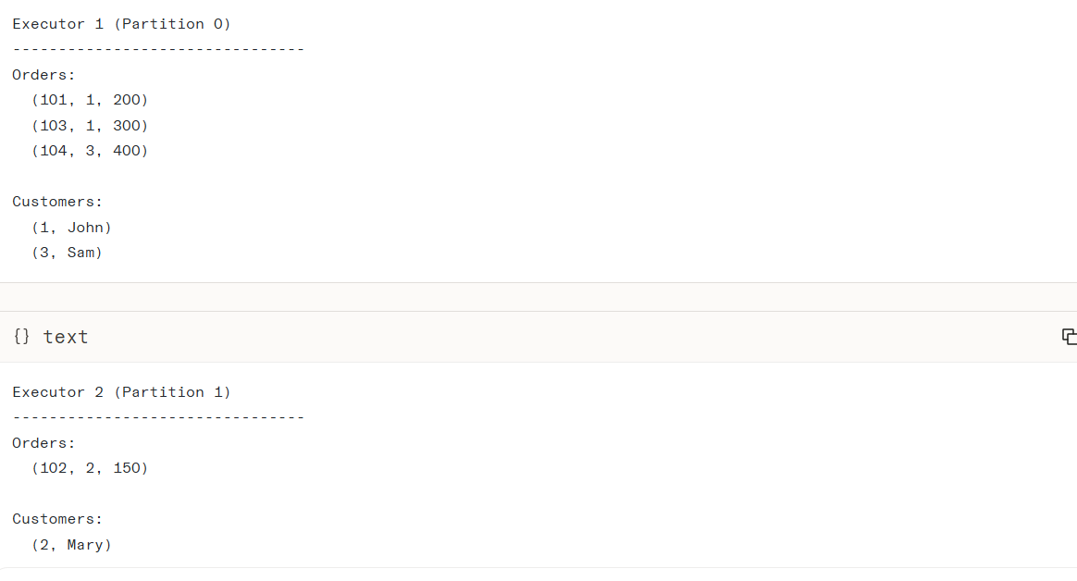
After Shuffle
Now What Happened?
  ✅ All rows with customer_id = 1 are together
  ✅ All rows with customer_id = 2 are together
  ✅ All rows with customer_id = 3 are together
Now join can happen LOCALLY inside each executor.
No more cross-machine dependency.

Slide 9
Example
spark.conf.set("spark.sql.join.preferSortMergeJoin", "false")
result = orders.join(customers, "customer_id")
result.explain(True)

Slide 10
Example
spark.conf.set("spark.sql.join.preferSortMergeJoin", "false")
result = orders.join(customers, "customer_id")
result.explain(True)

Slide 11
What is Sort Merge Join?
It is a method Spark uses to join two large tables. Instead of trying to compare every row of Table A with every row of Table B (which would take forever), it reorganizes the data first so that matching rows are sitting right next to each other.
Why Spark uses Sort Merge Join?
In Big Data, we often cannot fit all data into the computer's Memory (RAM).
  Broadcast Join works if one table is tiny.
  Hash Join needs a lot of memory to build a map.
  Sort Merge Join is the hero because it doesn't need to load everything into memory at once.
When does Spark choose this automatically?
Spark is smart. It chooses SMJ when:
  You are joining two Large tables.
  Neither table is small enough to fit in the Broadcast threshold (default 10MB).
  You are using equality joins (e.g., A.id == B.id).

Slide 12
STEP-BY-STEP INTERNAL WORKING
Step 1:Logical Plan (The Brain)
Where: Driver Node.
Action: You write df1.join(df2, "id"). The Driver looks at the file sizes. It sees both are large. It decides: "I will use Sort Merge Join."
Step 2: Physical Plan Selection
Where: Driver Node.
Action: The Driver instructs the Executors: "Prepare to Shuffle your data so matching keys end up on the same machine."
Step 3: The Shuffle Phase (The Network Move)
Where: Between Executors.
Why: To join data, ID=100 from Table A and ID=100 from Table B must be on the same computer.
Action: Spark hashes the Join Key.

Slide 13
Step 4: The Sorting Phase (The Heavy Lifting)
  Where: Inside Executors (Local Disk/RAM).
  Why: Merging is only fast if data is sorted.
Action: Now that Executor 1 has all the data for its specific keys, it sorts Table A by ID and Table B by ID.
Step 5: The Merge Phase (The Zipper)
  Where: Inside Executors.
  Action: The executor iterates through both sorted partitions simultaneously (like a zipper closing).
  It does not need to store the whole table in RAM. It just looks at the "current" row of both tables.
Step 6: Output Generation
  Where: Executors.
  Action: Matched rows are combined and sent to the next step (or saved to disk).

Slide 14
1. Sample Data (Initially Randomly Distributed)(large)
Table: CUSTOMERS (Large)
ID | Amount
3 | $50
1 | $10
4 | $40
2 | $20
ID | Name
2 | Bob
4 | Dave
1 | Alice
3 | Carol
After Shuffle (Exchange)
Spark redistributes data based on ID % 2 (Even/Odd).
Partition 1 (Odd IDs) - Held by Executor A
Orders: {ID:3, $50}, {ID:1, $10}
Customers: {ID:1, Alice}, {ID:3, Carol}
Partition 2 (Even IDs) - Held by Executor B
Orders: {ID:4, $40}, {ID:2, $20}
Customers: {ID:2, Bob}, {ID:4, Dave}
After Sorting (Local Sort)
Each Executor sorts its own data.
Partition 1 (Executor A)
Orders: 1 -> 3
Customers: 1 -> 3
Partition 2 (Executor B)
Orders: 2 -> 4
Customers: 2 -> 4

Slide 15
During Merge (Executor A Example)
Comparison 1:
Order Pointer: ID 1
Cust Pointer: ID 1
Match! Output: (1, $10, Alice) -> Advance both pointers.
Comparison 2:
Order Pointer: ID 3
Cust Pointer: ID 3
Match! Output: (3, $50, Carol) -> Advance both pointers.

Slide 16
PERFORMANCE IMPACT
When you see SMJ, you should expect certain costs:
Shuffle Cost (Network): This is the biggest slowdown. Moving terabytes of data across cables between computers takes time.
Sorting Cost (CPU): Sorting millions of rows takes CPU power.
Disk Spill (I/O): If RAM is full, Spark writes to disk. This is safe but slows things down significantly.

Slide 17
What is a Cross Join?
A Cross Join combines every single row of the first table with every single row of the second table.
It does not look for matching keys (like IDs). It just pairs everything with everything.
  Mathematical Name: Cartesian Product.
  The Formula: If Table A has MM rows and Table B has NN rows, the result has M×NM×N rows.
2. Why is this dangerous? (The "Explosion")
Imagine:
  Table A: 1,000 rows (Small)
  Table B: 1,000 rows (Small)
  Result: 1,000×1,000=1,000,0001,000×1,000=1,000,000 rows (1 Million).
Now imagine Big Data:
  Table A: 1 Million rows
  Table B: 1 Million rows
  Result: 1 Trillion rows! Your cluster will crash immediately.

Slide 18
Step 1: Logical Plan
Where: Driver.
  Action: You write df1.crossJoin(df2).
  Safety Check: Spark might throw an error saying, "Are you sure? This is expensive!" You might need to set spark.sql.crossJoin.enabled = true.
Step 2: Physical Plan (Nested Loop)
  Spark usually uses a strategy called Broadcast Nested Loop Join (BNLJ) or Cartesian Product.
Step 3: Distribution (The Heavy Lifting)
  Spark takes a partition of Table A.
  It needs to match this partition with the ENTIRETY of Table B.
  This means Table B is often sent (Broadcasted) to every single partition of Table A.
Step 4: The Loop (Inside Executor)
  The Executor opens Row 1 of Table A.
  It loops through ALL rows of Table B and creates pairs.
  It moves to Row 2 of Table A.
  It loops through ALL rows of Table B again.
Step 5: Output
  The number of rows grows massively, consuming huge amounts of memory and CPU.

Slide 19
Performance Tuning Points in Spark
Reduce Data Early
  Apply filter as early as possible
  Select only required columns (avoid select *)
  Use predicate pushdown (Parquet/ORC)
Less data = Less shuffle = Faster execution
Minimize Shuffle
Shuffle is the most expensive operation in Spark.
  Avoid unnecessary:
  groupBy
  distinct
  join
  repartition
Always check df.explain() for Exchange operators.

Slide 20
Use Proper File Format
Prefer:
  Parquet
  ORC
Avoid:
  CSV
  JSON (for large production datasets)
Why?
  Columnar storage
  Compression
  Predicate pushdown
Optimize Joins
  Broadcast small tables
  Avoid large-to-large joins when possible
  Repartition on join keys
  Handle skewed keys
Look for:
  BroadcastHashJoin (fast)
  SortMergeJoin (default for big data)

Slide 21
Use Proper File Format
Prefer:
  Parquet
  ORC
Avoid:
  CSV
  JSON (for large production datasets)
Why?
  Columnar storage
  Compression
  Predicate pushdown
Optimize Joins
  Broadcast small tables
  Avoid large-to-large joins when possible
  Repartition on join keys
  Handle skewed keys
Look for:
  BroadcastHashJoin (fast)
  SortMergeJoin (default for big data)

Slide 22
Tune Shuffle Partitions
Default:
spark.sql.shuffle.partitions = 200
Adjust based on:
Cluster cores
Data size
Rule of thumb:
2–3 × total cores
Manage Partitions Properly
Too many partitions → overhead
Too few partitions → underutilization
Use:
repartition() (with shuffle)
coalesce() (reduce partitions without shuffle)

Slide 23
Handle Data Skew
Symptoms:
One task runs much longer
Uneven task duration
Solutions:
Salting
Broadcast join
Skew hints (Spark 3+)
Adaptive Query Execution (AQE)
Use Caching Carefully
Cache only if:
Data reused multiple times
Avoid:
Caching everything
Caching huge DataFrames unnecessarily
Always trigger cache:
df.cache()
df.count()

Slide 24
Enable Adaptive Query Execution (AQE)
spark.conf.set("spark.sql.adaptive.enabled", "true")
AQE:
Optimizes join strategy dynamically
Handles skew automatically
Reduces shuffle partitions
Avoid Common Anti-Patterns
  ❌ collect() on large dataset
  ❌ show() on massive DataFrame
  ❌ Writing too many small files
  ❌ Too many withColumn() transformations
  ❌ Not checking execution plan
Golden Rule for Freshers
Spark Performance =
Reduce Data + Reduce Shuffle + Right Join Strategy + Proper Partitioning

Slide 25
What is Bucketing in Spark?
  Bucketing is a technique where Spark:
  Divides data into a fixed number of files (buckets) based on a hash of a column.
  It is mainly used to optimize joins and aggregations.
Example
A large library has:
  1 million books
  10 shelves
  Each book is placed on a shelf using:
  hash(book_id) % 10
df.write \
.format("parquet") \
.bucketBy(8, "customer_id") \
.sortBy("customer_id") \
.mode("overwrite") \
.saveAsTable("bucketed_customers")

Slide 26
Differences
Feature | Partitioning | Bucketing
Split Type | Folder level | File level
Based On | Column value | Hash function
Number | Depends on distinct values | Fixed number
Shuffle Avoidance | No | Yes (if both tables bucketed same way)
Works With | save() or saveAsTable() | Only saveAsTable()
Good For | Filtering | Joining

